Slide 1

Software Project Management in Well-established Organizations
The Better Team
Natnael Kebede
Project Manager
April 2, 2018
The Project Team:
Carlos Bustos
Julian Cisneros
Natnael Kebede Octavio Garcia
CSE-4322 – Software Project Management

Slide 2
Agenda
Project Description
Design approach and methods Used
Risks/consequences
Problem and solution approach
Software project management practices
Well-established organizations and the software projects they work on
Size of projects, platforms and development time
Methods and techniques to manage the projects
Summary
Questions and Answers

Slide 3
Project Description
Research about software project management practices in real world organizations.
In-depth look at the way projects are managed in already well-established organizations.
Deliverables
Presentation April 2, 2018

Slide 4

Design Approach
All team members researched the project topic to obtain background information.
Contents of the project were assigned into individual tasks.
Set up schedules for each team member to research their respective section.

Slide 5
Design Approach
Project sections:
Well-established organizations and the projects they work on.
Information about the projects.
Mechanisms in place to manage these projects.
Discussed and analyzed the gathered information and structured it into a presentation.

Slide 6

Problems and Solutions
Lack of detailed Information
Examined and gathered contents according to common specific standards.

Slide 7

Risks
Conflicting information
Biased information
Undisclosed information

Slide 8
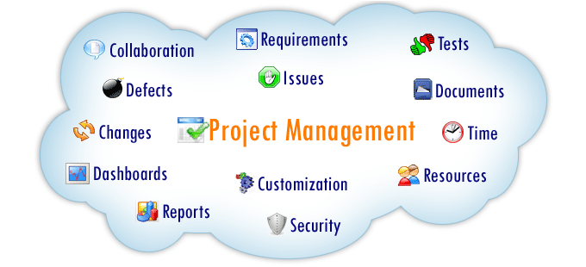
Software project management practices
Differs from one company to another. However they all share common practices.

Slide 9
Well-established organizations
Have existed and been successful for a longer period of time.
Characterized by
Strong organization and timing
Knowing their competition
Knowing their risks and rewards
Consistency
Excellent service and innovation

Slide 10




Well-established organizations continued
Common companies that represent such type of organizations include
Organizations | Projects they work on
Microsoft | Embedded, Mobile
 | Embedded, Web, Mobile, Open source
 | Embedded, Mobile
 | Embedded, Mobile, Open source

Slide 11


Size of projects, platforms and development time
Microsoft Planner: a project management app developed by Microsoft to help business and small team to collaborate and track work.
LOC: estimated to be at least 30 million
Cost: undisclosed
Time: At least 2 years and the initial release was June 6, 2016
Programming language: primarily C, C++, C#, Java

Slide 12

Size of projects, platforms and development time
Infer: Static analyzer in deployment at Facebook. used for development process for mobile apps, detect bugs, resource and memory leaks
LOC: Thousands of lines and maybe more
Cost: undisclosed
Time: A couple of years, created in June 2015 and still going on.
Programming language: Mainly focused on Java

Slide 13

Size of projects, platforms and development time continued
Amazon’s Echo: Smart speaker device accompanied by a Virtual assistant developed by amazon
LOC: undisclosed
Cost: $330 million in 2016
Time: First release in Nov 2014 but software development took two years and still going on
Programming language: Front end: Voice User Interface (VUI) Backend: Node.js (JavaScript), java, Python, C# and Go

Slide 14

Size of projects, platforms and development time continued
Google’s Android OS:
LOC: 12-15 million
Cost: $50 million in 2005
Time: Version take a couple of years.
Programming language: Currently Kotlin, previously Java

Slide 15
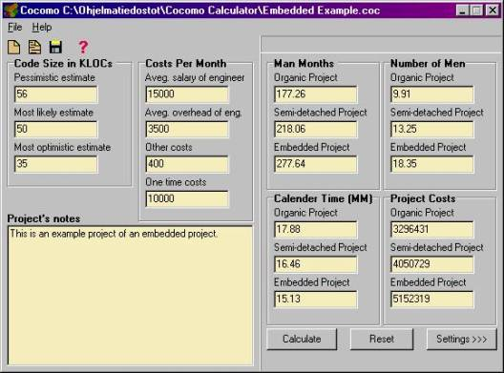
Methods and techniques to manage the projects
Cost estimation technique
COCOMO (Constructive Cost Model)
Provides rough estimate of the project cost to the customer and provides the team with a quick outlook of what is expected from the team.

Slide 16
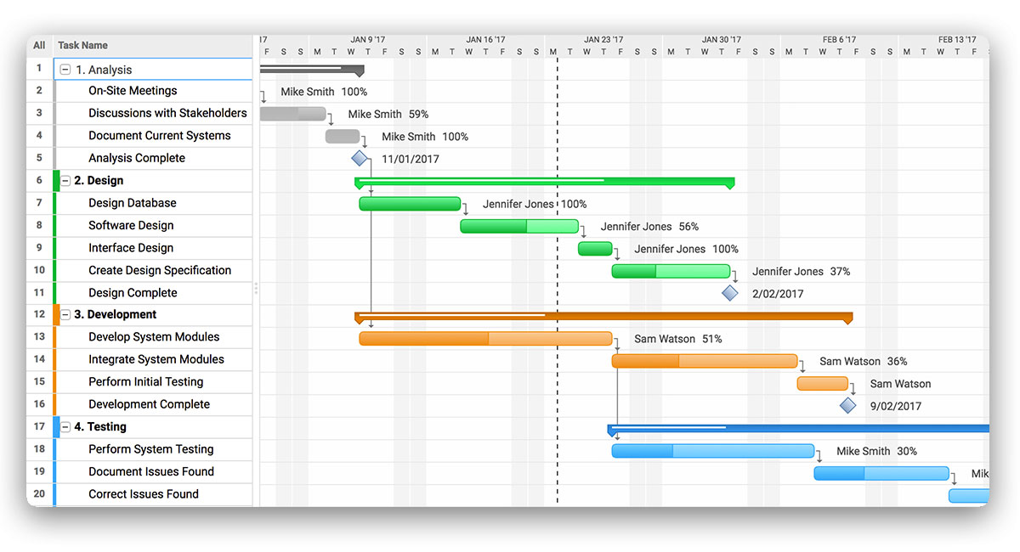
Methods and techniques to manage the projects continued
Schedule techniques
GANTT Chart
Provides visual representation of the
project schedule, progress, set milestone (what functions are working) and keeps team on the same page.

Slide 17
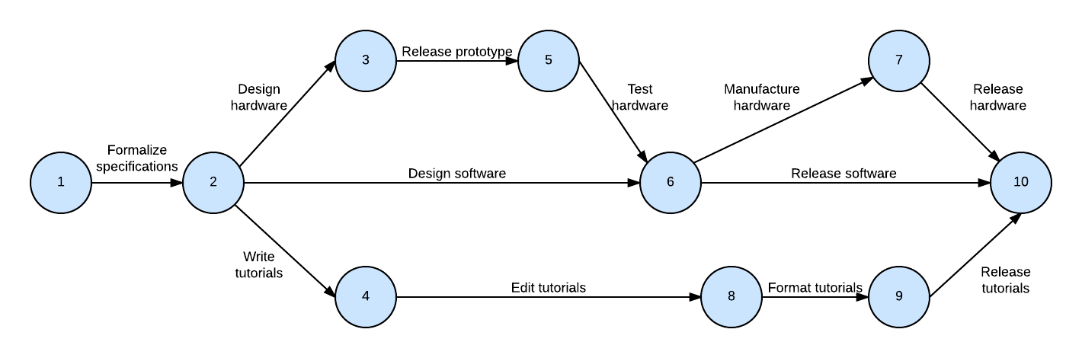
Methods and techniques to manage the projects continued
Schedule techniques
PERT Chart
Provides graphical representation of the
project and dependent tasks (numbers).
Nodes: events/milestones.
Arrows: represent tasks as transitions between nodes.
Paths: selected depending on available resources

Slide 18
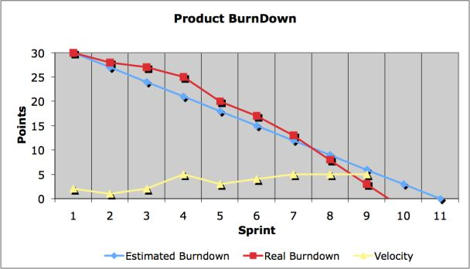
Methods and techniques to manage the projects continued
Schedule techniques
SCRUM
Features are written from end user’s perspective (user stories - product backlog).
Sprints: dedicated timeline to complete tasks.
Burndown chart: shows remaining work and helps predict timeline to complete it.
Agile development Used by: Google, Microsoft…

Slide 19
Project Schedule
Task Name | Assignee | Est. Start Date | Actual Start Date | Est. Complete Date | Actual Complete Date | Est. # Hours | Actual Hours | % complete
Research about software project management practices in real world organizations. | All | February 23, 2018 | February 23, 2018 | February 25, 2018 | February 25, 2018 | 2 | 2 | 100
Obtain information about what well established organizations are, what companies represent such types of organizations and the types of software projects they work on (embedded, IT, Mobile, etc.) | Carlos Bustos | March 2, 2018 | March 14, 2018 | March 15, 2018 | March 14, 2018 | 3 | 3 | 100
Obtain information about how large these software projects are (SLOCs and spent development time) and the set ups and platforms used to implement them. | Octavio Garcia | March 3, 2018 | March 14, 2018 | March 5, 2018 | March 16, 2018 | 3 | 4 | 133
Notes:
s

Slide 20
Project Schedule
Obtain information about the methods or techniques used to manage such projects and its significance/effectiveness in terms of schedule, cost and delivery. | Julian Cisneros | March 5, 2018 | March 15, 2018 | March 7, 2018 | March 21, 2018 | 3 | 5 | 166
Discussion of the information gathered | All | March 9, 2018 | March 9, 2018 | March 9, 2018 | March 9, 2018 | 3 | 3 | 100
Collect and analyze the information provided by team members | Natnael Kebede | March 20, 2018 | March 20, 2018 | March 23, 2018 | March 23, 2018 | 4 | 4 | 100
Power Point Implementation | Natnael Kebede | March 11, 2018 | March 23, 2018 | March 16, 2018 | March 23, 2018 | 5 | 5 | 100
Presentation Walkthrough | All | March 24, 2018 | March 26, 2018 | March 24, 2018 | March 26, 2018 | 3 | 2 | 66.6
Presentation Rehearsal with team members | All | March 25, 2018 | March 25, 2018 | March 25, 2018 | March 25, 2018 | 2 | 2 | 100
Totals |  |  |  |  |  | 28 | 30 | 107.2

Slide 21
Summary
Software project management depends on the company’s capacity and goals.
Well-established organizations have strong qualities to maintain their standard and keep growing.
Some representatives of such organizations include Microsoft, Facebook, Amazon, and Google.
Such organization work on large products consisting of million lines of code and high cost.
Schedule and cost estimation techniques are essential in terms of schedule, cost and delivery.

Slide 22
References
“A Brief History of Google's Android Operating System.” IPWatchdog.com | Patents & Patent Law, 25 Nov. 2014, www.ipwatchdog.com/2014/11/26/a-brief-history-of-googles-android-operating-system/id=52285/.
Albro, Edward N. Tom's Planner: Drag-and-Drop Gannt Charts. vol. 28, IDG Consumer & SMB, Inc, 2010.
“Alexa Programming Languages and Tools.” Sascha Wolter, 22 Mar. 2018, www.wolter.biz/2017/12/alexa-programming-languages-and-tools
Hudson, Shannon M., and Marilyn A. Laken. "Use of a PERT Chart to Improve Efficiency of the Dissertation." Nursing Education Perspectives, vol. 36, no. 4, 2015, pp. 257-258.
Iraji, Mohammad S. "Fuzzy Agent Oriented Software Effort Estimate with COCOMO." International Journal of Intelligent Systems and Applications, vol. 7, no. 8, 2015, pp. 18.
Johnston, Robert. "Panama City radiotherapy accident, 2000-2001." Panama City radiotherapy accident, 2000-2001. January 21, 2004. Accessed February 23, 2018. http://www.johnstonsarchive.net/nuclear/radevents/2000PAN1.html

Slide 23
References
Maximini, Dominik, and Ebooks Corporation. The Scrum Culture: Introducing Agile Methods in Organizations. Springer, New York;Cham;, 2015, doi:10.1007/978-3-319-11827-7.
McCracken, Harry. “Echo And Alexa Are Two Years Old. Here's What Amazon Has Learned So Far.” Fast Company, Fast Company, 2 May 2017, www.fastcompany.com/3065179/echo-and-alexa-are-two-years-old-heres-what-amazon-has-learned-so-far.
“Open-Sourcing Facebook Infer: Identify Bugs before You Ship.” Facebook Code, code.facebook.com/posts/1648953042007882/open-sourcing-facebook-infer-identify-bugs-before-you-ship/.
Seabury, Chris. “9 Tips For Growing a Successful Business.” Investopedia, 12 Mar. 2018, www.investopedia.com/articles/pf/08/make-money-in-business.asp.
Statt, Nick. “Microsoft Launches a Project Management App Called Planner.” The Verge, The Verge, 6 June 2016, www.theverge.com/2016/6/6/11868998/microsoft-planner-office-app-launch-2016-trello-asana..

Slide 24
Q/A

Slide 25


